Slide 1
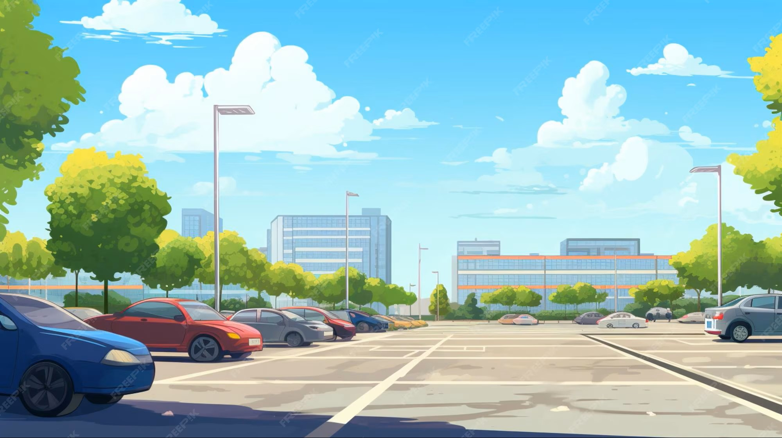
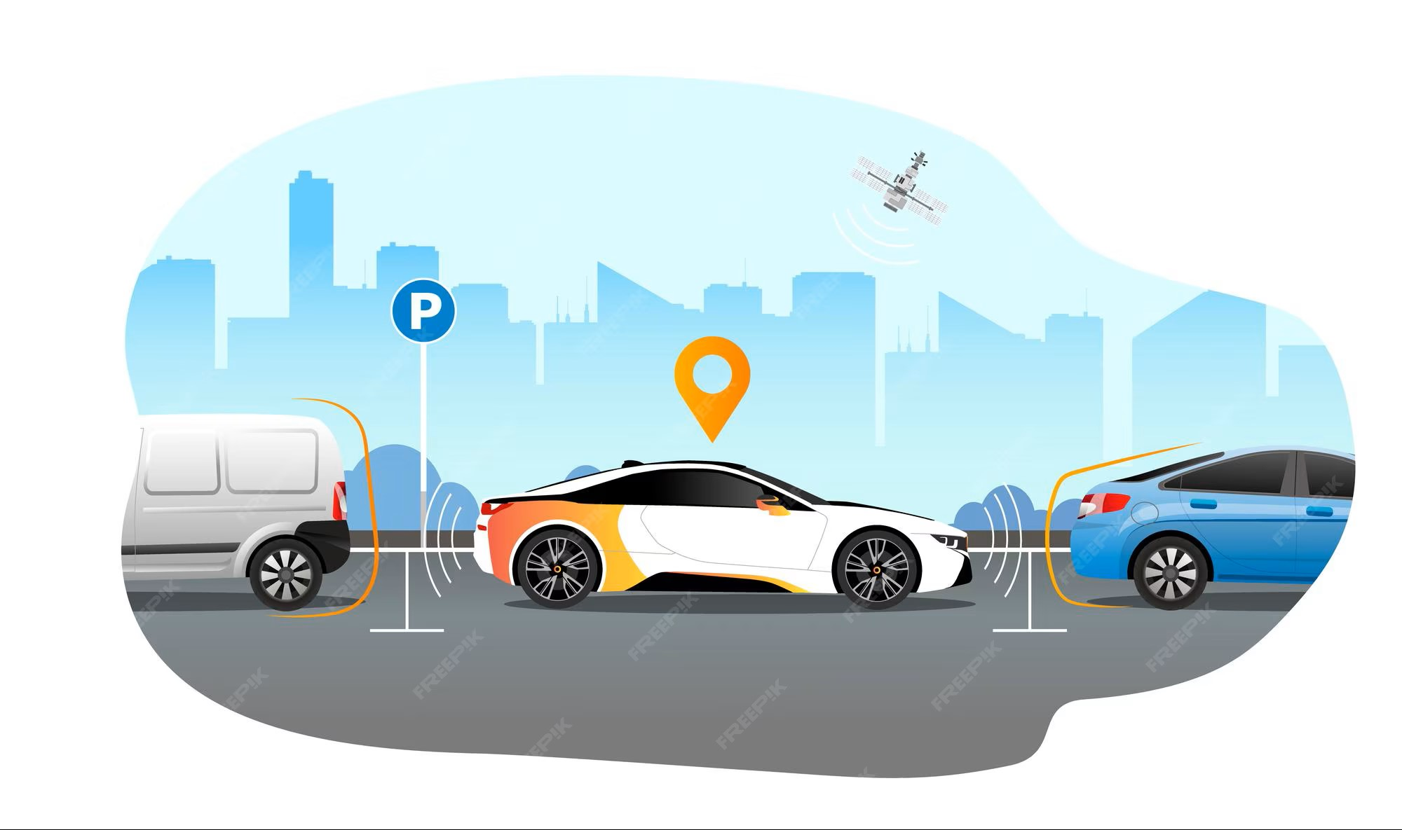
ParkPal
UX Case Study
Mentors:
Researcher & Designer:
Kirubakaran V (2023503546)
Perumall rishi P (2023503551)
Sowmiya Narayanan (2023503582)
Dharanidharan L (2023503508)
Sibichakaravarthi (2023503027)
Soorya Prakash R (2023503502)
Duration:

Slide 2

Features Roadmap
A feature roadmap is important for the ParkPal project because it gives a clear direction for how the app will grow step by step. It helps us understand what features to build first and what to add later, making the whole development process easier and more organized. With a roadmap, the team can work smoothly, avoid confusion, and stay focused on the same goals. It also makes it simple to explain the project plan to others and show how ParkPal will improve from a basic parking app into a complete smart parking solution.

Slide 3
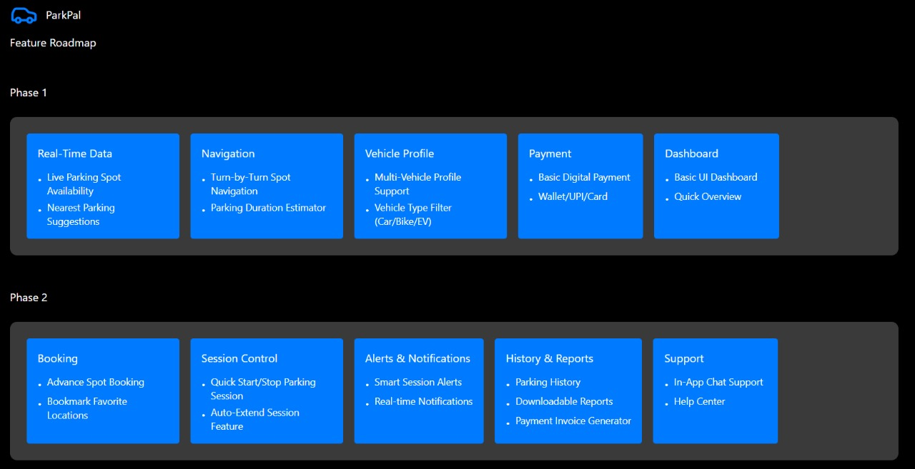
Phase 1 & Phase 2

Slide 4
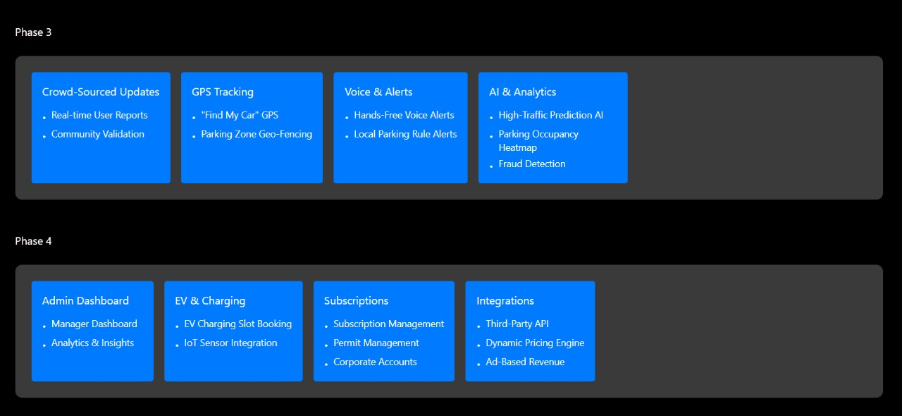
Phase 3 & Phase 4

Slide 5
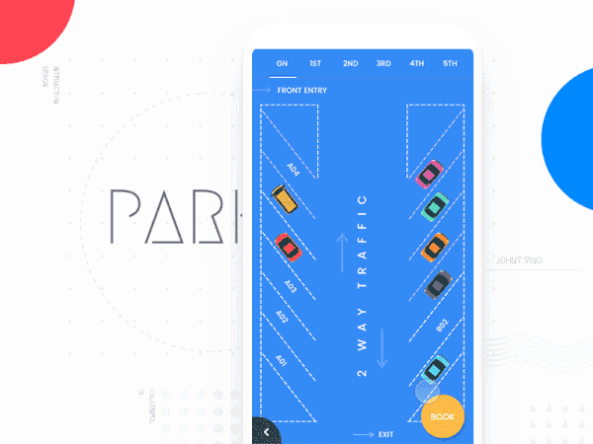
Platforms and Resolutions
For ParkPal, I chose a cross-platform design so the app can run smoothly on all major devices. Since parking information must be accessible anywhere, supporting multiple screen sizes is essential. I also included four modes—Dark Mode, Light Mode, Dark Accessibility Mode, and Light Accessibility Mode—to ensure that users with visual difficulties, including color blindness, can use the app comfortably.
The resolutions I designed for are (pixels):
Mobile : 0 ~ 559
Phablet : 560 ~ 769
Tablet : 770 ~ 991
Desktop Small : 992 ~ 1439
Desktop Large : 1440 ~ 2559
4K Display : 2560 and above

